Slide 1
Principles of Parallel Algorithm Design
Ananth Grama, Anshul Gupta, George Karypis, and Vipin Kumar
To accompany the text “Introduction to Parallel Computing”,
Addison Wesley, 2003.

Slide 2
Preliminaries: Decomposition, Tasks, and
Dependency Graphs
The first step in developing a parallel algorithm is to decompose the problem into tasks that can be executed concurrently
A given problem may be docomposed into tasks in many different ways.
Tasks may be of same, different, or even interminate sizes.
A decomposition can be illustrated in the form of a directed graph with nodes corresponding to tasks and edges indicating that the result of one task is required for processing the next. Such a graph is called a task dependency graph.

Slide 3
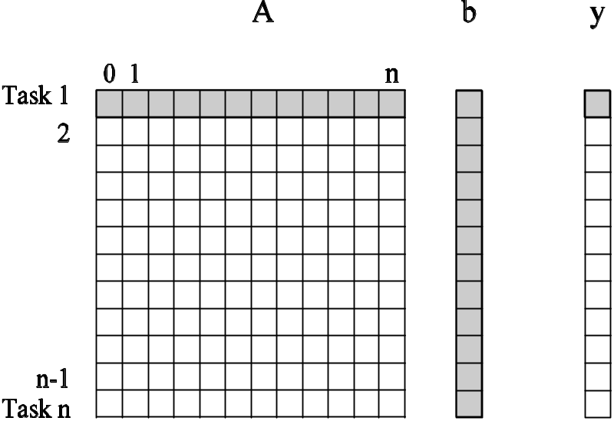
Example: Multiplying a Dense Matrix with a Vector
Computation of each element of output vector y is independent of other elements. Based on this, a dense matrix-vector product can be decomposed into n tasks. The figure highlights the portion of the matrix and vector accessed by Task 1.
Observations: While tasks share data (namely, the vector b ), they do not have any control dependencies - i.e., no task needs to wait for the (partial) completion of any other. All tasks are of the same size in terms of number of operations. Is this the maximum number of tasks we could decompose this problem into?

Slide 4
Example: Database Query Processing
Consider the execution of the query:
MODEL = ``CIVIC'' AND YEAR = 2001 AND
(COLOR = ``GREEN'' OR COLOR = ``WHITE)
on the following database:
ID# | Model | Year | Color | Dealer | Price
4523 | Civic | 2002 | Blue | MN | $18,000
3476 | Corolla | 1999 | White | IL | $15,000
7623 | Camry | 2001 | Green | NY | $21,000
9834 | Prius | 2001 | Green | CA | $18,000
6734 | Civic | 2001 | White | OR | $17,000
5342 | Altima | 2001 | Green | FL | $19,000
3845 | Maxima | 2001 | Blue | NY | $22,000
8354 | Accord | 2000 | Green | VT | $18,000
4395 | Civic | 2001 | Red | CA | $17,000
7352 | Civic | 2002 | Red | WA | $18,000

Slide 5
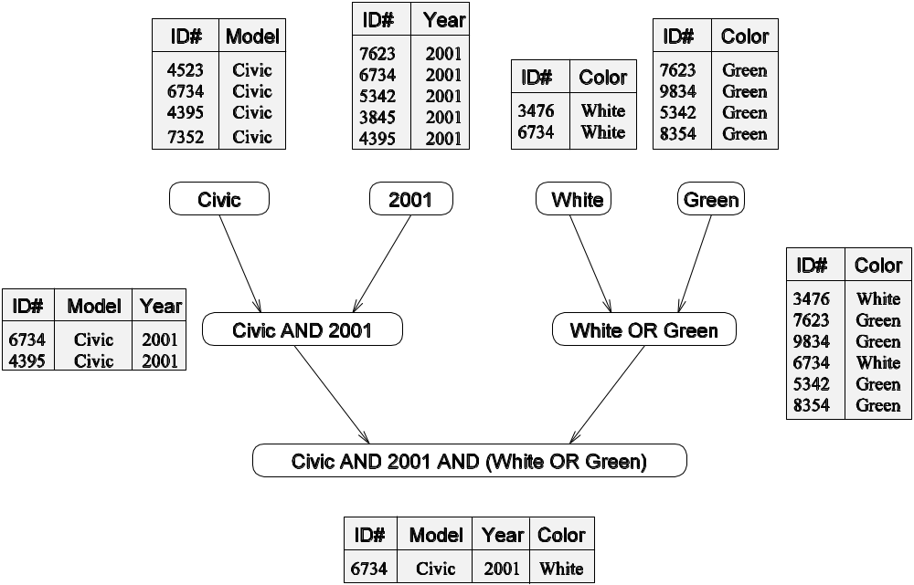
Example: Database Query Processing
The execution of the query can be divided into subtasks in various
ways. Each task can be thought of as generating an intermediate
table of entries that satisfy a particular clause.
Decomposing the given query into a number of tasks.
Edges in this graph denote that the output of one task
is needed to accomplish the next.

Slide 6
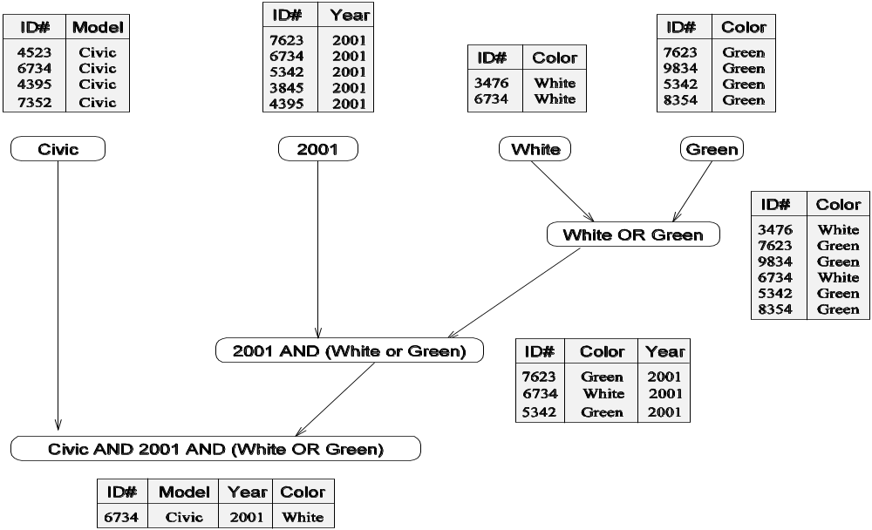
Example: Database Query Processing
Note that the same problem can be decomposed into subtasks in other
ways as well.
An alternate decomposition of the given problem into
subtasks, along with their data dependencies.
Different task decompositions may lead to significant differences with
respect to their eventual parallel performance.

Slide 7
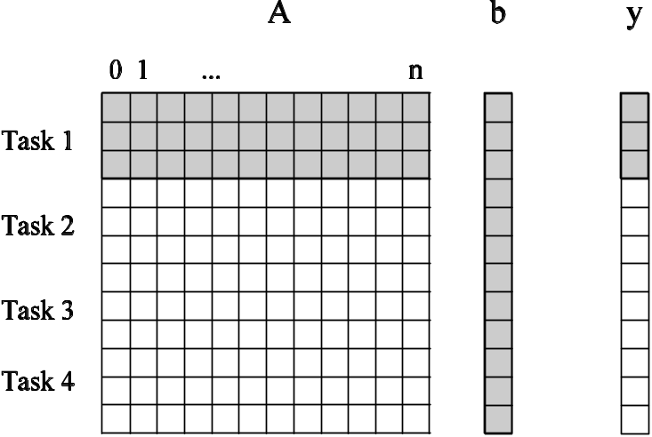
Granularity of Task Decompositions
The number of tasks into which a problem is decomposed determines its granularity.
Decomposition into a large number of tasks results in fine-grained decomposition and that into a small number of tasks results in a coarse grained decomposition.
A coarse grained counterpart to the dense matrix-vector product example. Each task in this example corresponds to the computation of three elements of the result vector.

Slide 8
Degree of Concurrency
The number of tasks that can be executed in parallel is the degree of concurrency of a decomposition.
Since the number of tasks that can be executed in parallel may change over program execution, the maximum degree of concurrency is the maximum number of such tasks at any point during execution. What is the maximum degree of concurrency of the database query examples?
The average degree of concurrency is the average number of tasks that can be processed in parallel over the execution of the program. Assuming that each tasks in the database example takes identical processing time, what is the average degree of concurrency in each decomposition?
Average Degree of Concurrency = Total Amount of Work / Critical Path Length
The degree of concurrency increases as the decomposition becomes finer in granularity and vice versa.

Slide 9
Critical Path Length
A directed path in the task dependency graph represents a sequence of tasks that must be processed one after the other.
The longest such path determines the shortest time in which the program can be executed in parallel.
The length of the longest path in a task dependency graph is called the critical path length.

Slide 10
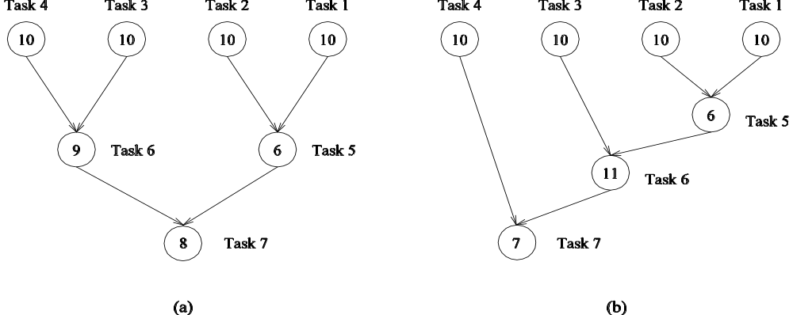
Critical Path Length
Consider the task dependency graphs of the two database query
decompositions:
What are the critical path lengths for the two task dependency graphs?
If each task takes 10 time units, what is the shortest parallel execution time
for each decomposition? How many processors are needed in each case to
achieve this minimum parallel execution time? What is the maximum
degree of concurrency?

